Slide 1
Training Data Extraction From Pre-trained Language Models A Survey

Slide 2
Summary
This study provides a comprehensive survey of training data extraction from pre-trained language models (PLMs), covering various definitions of memorization, attack and defense approaches, empirical findings, and future research directions.

Slide 3
Contents
Background and Contribution
Preliminaries about PLMs
Definitions of Memorization
Training Data Extraction Attacks
Training Data Extraction Defense
Findings
Conclusion and Future Works

Slide 4
Contents
Background and Contribution
Preliminaries about PLMs
Definitions of Memorization
Training Data Extraction Attacks
Training Data Extraction Defense
Findings
Conclusion and Future Works

Slide 5
Background
Pre-trained language models (PLMs) are widely used in natural language processing (NLP), and their scaling with large datasets has led to success in various downstream tasks.
However, the increasing applications of PLMs have raised security concerns regarding the potential extraction of training data, posing a threat to data privacy.
There is a need for more research and development to address these security concerns.

Slide 6
Contribution
The main contribution is as follows:
1. Provides a comprehensive survey of training data extraction from pre-trained language models (PLMs) in the fields of natural language processing and security.
2. Recaps preliminary knowledge and presents a taxonomy of various definitions of memorization.
3. Systemizes the approaches for attack and defense in training data extraction from PLMs.
4. Highlights the empirical findings of several quantitative studies on training data extraction from PLMs.
5. Suggest future research directions based on the review conducted.

Slide 7
Contents
Background and Contribution
Preliminaries about PLMs
Definitions of Memorization
Training Data Extraction Attacks
Training Data Extraction Defense
Findings
Conclusion and Future Works

Slide 8
Preliminaries about PLMs
PLMs are machine learning models that have been trained on large amounts of text data and can be fine-tuned for specific NLP tasks.
These models learn general language features, such as grammar, syntax, and semantics, which can be adapted to various NLP tasks, such as sentiment analysis, named entity recognition, and text summarization.
For this paper, we discuss the following Preliminaries
Language Models
Pre-training and Fine-tuning

Slide 9
Language Models
Language models are the foundation of modern NLP. It uses statistical analysis to learn the patterns of human language and predict the next word in a sequence.
Based on the pre-trained method, the language models are two types.
Autoregressive language models and
Masked language models
Autoregressive language models predict words sequentially from left to right
Masked language models hide some parts of a sentence and fills in the gaps.
This study focuses on autoregressive language models with transformer architecture.

Slide 10
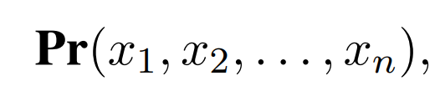
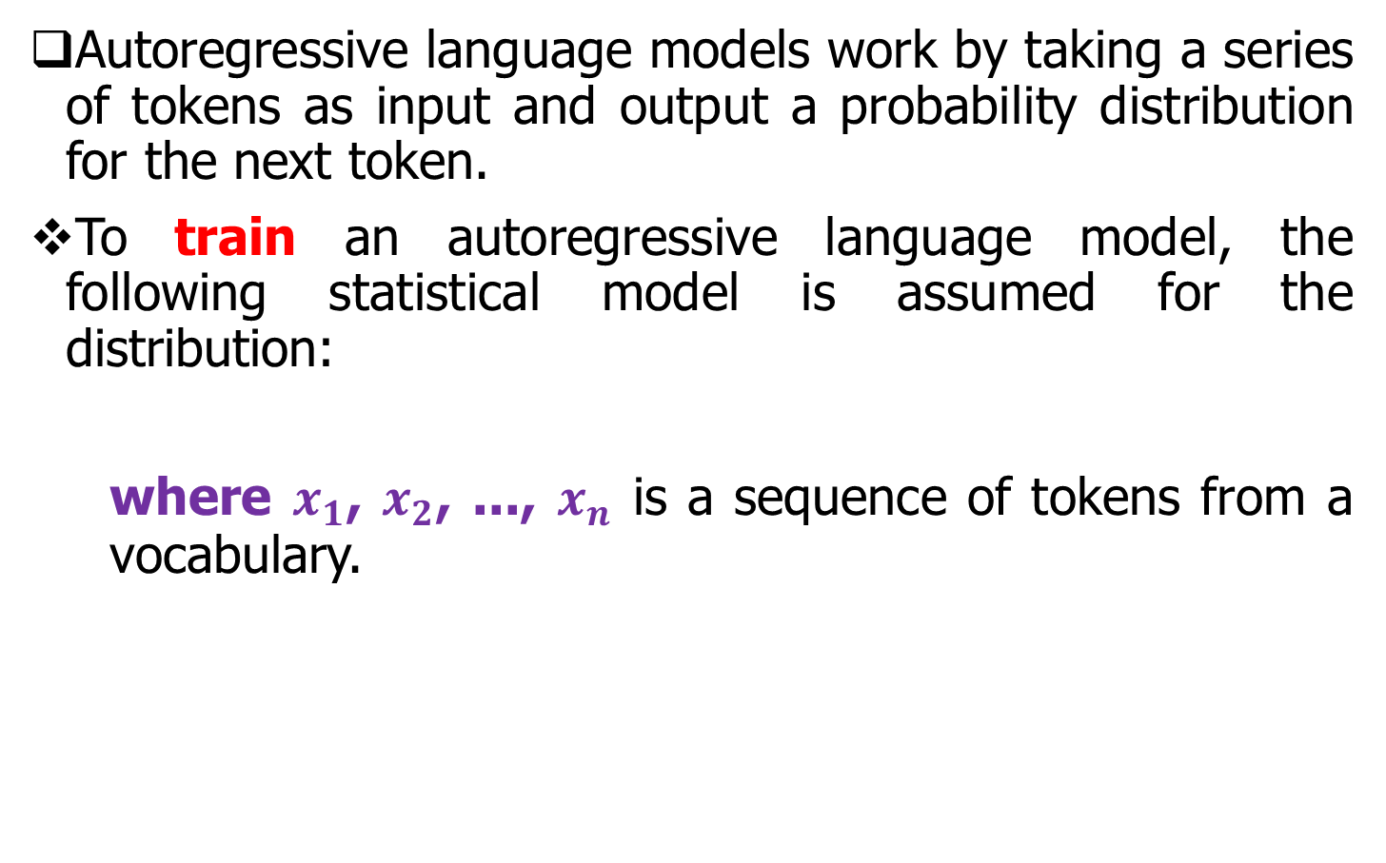
Autoregressive Language Model (1/3)
Autoregressive language models work by taking a series of tokens as input and output a probability distribution for the next token.
To train an autoregressive language model, the following statistical model is assumed for the distribution:
where $x_{1}$, $x_{2}$, ..., $x_{n}$ is a sequence of tokens from a vocabulary.

Slide 11
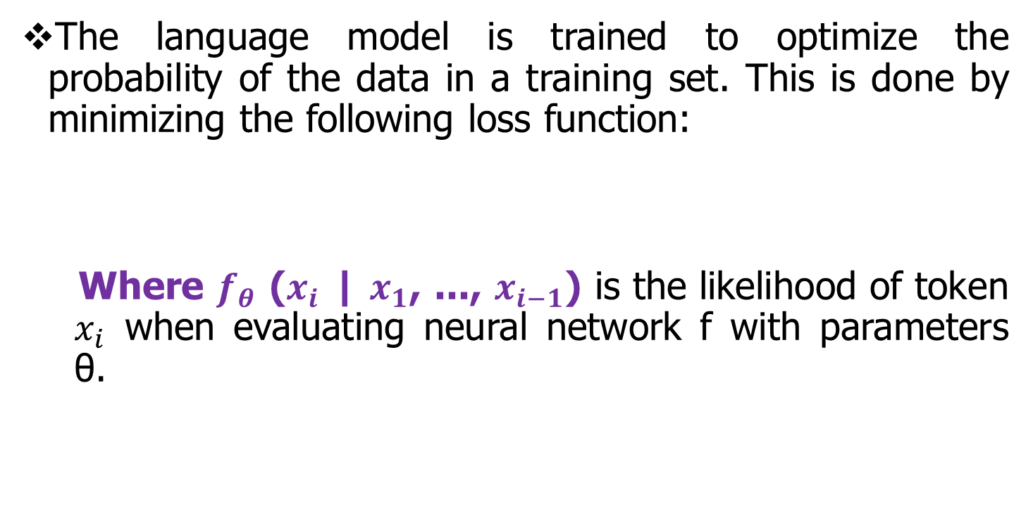
Autoregressive Language Model (2/3)
The language model is trained to optimize the probability of the data in a training set. This is done by minimizing the following loss function:
Where $f_{θ}$ ($x_{i}$ | $x_{1}$, ..., $x_{i−1}$) is the likelihood of token $x_{i}$ when evaluating neural network f with parameters θ.

Slide 12
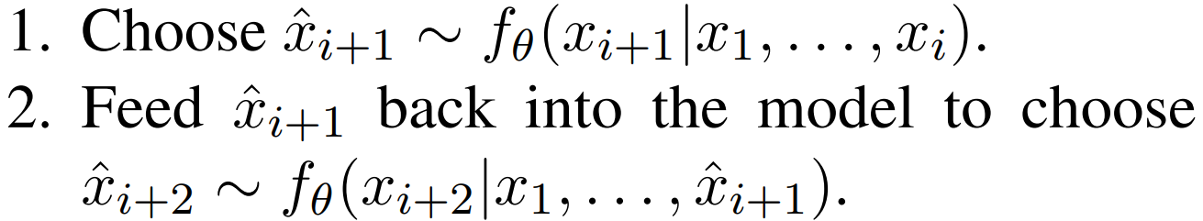
Autoregressive Language Model (3/3)
Once the language model is trained, it can be used to generate new text by iteratively following the following process:
This decoding process continues until conditions are satisfied.
However, studies have shown that simply maximizing the output probability of the language model generates text that is not natural to humans.
Therefore, several approaches have been proposed for sampling from the probability distribution, such as top-k sampling and top-p sampling.

Slide 13
Pre-training and Fine-tuning
Pre-training and fine-tuning is a common approach in natural language processing where large neural networks are trained on large datasets for multiple downstream tasks.
Autoregressive language modeling has been found to be effective for pre-trained language models with transformers, such as GPT-2 and GPT-3, which can be applied to various tasks without fine-tuning.
PLMs offer advantages in domain-specific tasks when trained on datasets that match a specific domain, but there are potential risks related to sensitive data extraction and ethical considerations.

Slide 14
Sensitive Datasets
Examples of PLMs created from sensitive datasets
PLMs created from contracts
PLMs created from clinical information
PLMs created from music
PLMs created from source code

Slide 15
Contents
Background and Contribution
Preliminaries about PLMs
Definitions of Memorization
Training Data Extraction Attacks
Training Data Extraction Defense
Findings
Conclusion and Future Works

Slide 16
Definitions of Memorization
Memorization refers to the ability of PLMs to store and output information about the training data.
Type of memorization is as follows:
Eidetic memorization
Differential privacy
Counterfactual memorization
Approximate memorization
Revisiting model inversion

Slide 17
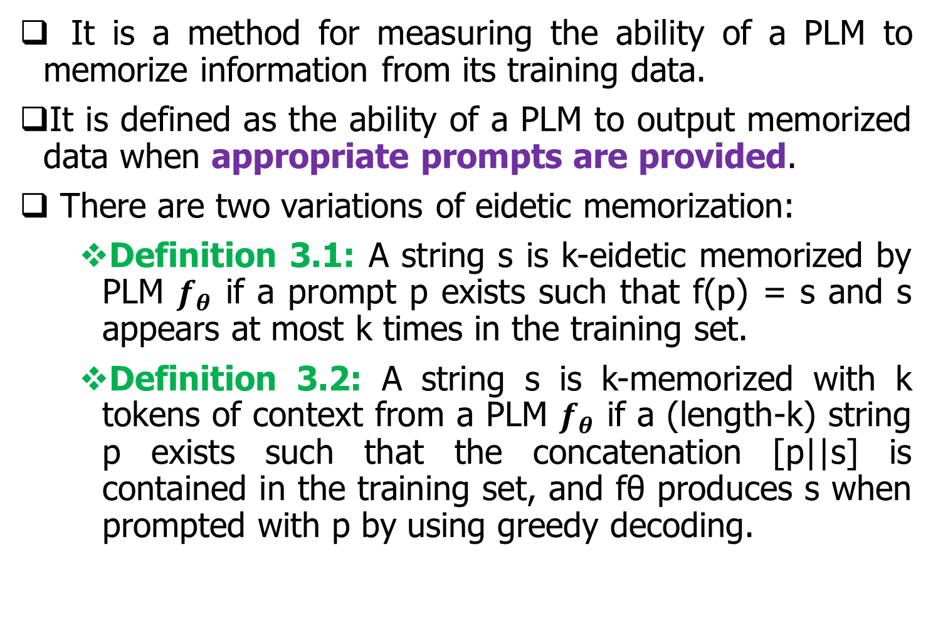
Eidetic Memorization
It is a method for measuring the ability of a PLM to memorize information from its training data.
It is defined as the ability of a PLM to output memorized data when appropriate prompts are provided.
There are two variations of eidetic memorization:
Definition 3.1: A string s is k-eidetic memorized by PLM $f_{θ}$ if a prompt p exists such that f(p) = s and s appears at most k times in the training set.
Definition 3.2: A string s is k-memorized with k tokens of context from a PLM $f_{θ}$ if a (length-k) string p exists such that the concatenation [p||s] is contained in the training set, and fθ produces s when prompted with p by using greedy decoding.

Slide 18
Differential Privacy
It is a concept that aims to protect the privacy of individuals when analyzing or sharing data.
It was formulated based on the idea that removing any data from a training set should not significantly change the trained models.
It has been widely used in various fields, including memorization, where it has been employed as a defense approach against training data extraction from PLMs.

Slide 19
Counterfactual Memorization
It is a measure of how well a PLM has memorized its training data.
It refers to the measurement of the difference in expected loss between a model that has been trained on a specific training data and a model that has not been trained on that data.
There are several challenges associated with evaluating counterfactual memorization in PLMs.
First, it requires training thousands of models, which can be computationally expensive.
Second, it is not considered a privacy attack scenario.

Slide 20
Approximate Memorization
It is a method used to relax the condition of exact string matches when evaluating the memorization capabilities of PLMs.
It considers string fuzziness and allows for variations in the matching criteria.
Some approaches have been proposed to calculate similarity, such as using the BLEU score, where a threshold value of 0.75 has been set to determine approximate memorization.
Another definition of approximate memorization involves considering a token as memorized if it is part of a substring of 50 tokens in the training data.

Slide 21
Revisiting Model Inversion
Revisiting model inversion involves reconstructing the training data from a model.
Model inversion attacks aim to extract sensitive information from a trained model by leveraging its outputs.

Slide 22
Contents
Background and Contribution
Preliminaries about PLMs
Definitions of Memorization
Training Data Extraction Attacks
Training Data Extraction Defense
Findings
Conclusion and Future Works

Slide 23
Training Data Extraction Attacks
Training data extraction attacks refer to the process of extracting sensitive training data from PLMs in a malicious manner, which poses a threat to data privacy and security.
These attacks aim to retrieve verbatim text sequences that were used to train the PLMs.
The attack procedure typically involves two steps:
Candidate generation and
Membership inference.

Slide 24
Candidate Generation
Candidate generation is a step in the procedure of extracting training data from PLMs.
It involves generating text sequences from PLMs using various decoding methods such as greedy method, top-k sampling, and temperature tuning.
The goal of candidate generation is to generate a diverse set of text sequences that are as likely as possible to be in the training data which can be used for membership inference in the next step.

Slide 25
Membership Inference
Membership inference aims to predict whether any particular example is used to train a machine learning model.
This can lead directly to privacy violations, as it could allow attackers to access sensitive information that was used to train the model.
Membership inference on PLMs can be described using the following 5 perspectives
Target model
Adversarial knowledge
Approach
Algorithm
Domain

Slide 26
Target model
Membership inference attacks typically focus on autoregressive language models, such as GPT-3.
This is because autoregressive language models are able to generate text that is similar to the text in the training data.
This makes it easier for attackers to infer whether a particular input was in the training data.

Slide 27
Adversarial Knowledge (1/2)
It is the knowledge that the attacker has about the model, such as its architecture, parameters, and training data.
This knowledge can be used by the attacker to improve their chances of successfully performing a membership inference attack.
The two main categories of adversarial knowledge are
White-box and
Black-box.
White-box knowledge: This is the knowledge that the attacker has complete access to the model, including its architecture, parameters, and training data.

Slide 28
Adversarial Knowledge (2/2)
Black-box knowledge: This is the knowledge that the attacker does not have access to the model's parameters or architecture, but they have access to the model's outputs.
Different levels of black-box knowledge.
Full confidence scores: This is the level of knowledge where the attacker can obtain the model's confidence scores for all outputs.
Top-k confidence scores: This is the level of knowledge where the attacker can only obtain the model's top-k confidence scores.
Prediction labels only: This is the lowest level of black-box knowledge. The attacker can only obtain the model's prediction labels for each output.

Slide 29
Approach
Hu et al. (2022) have divided the membership inference approaches into three categories:
Classifier-based methods train a classifier to distinguish between inputs that were used to train the model and inputs that were not.
Metric-based methods measure the similarity between an input and the training data.
Differential comparison methods compare the predictions of the model on inputs that were used to train the model and inputs that were not.
In the context of training data extraction from PLMs, perplexity can be used to determine whether a particular sequence of tokens was part of the training data used to train the model.
[1]. Hongsheng Hu, Zoran Salcic, Lichao Sun, et al. 2022. Membership inference attacks on machine learning: A survey. ACM Computing Surveys, 54(11s).

Slide 30
Algorithm
The perspective of whether the algorithm used for training data extraction is centralized or federated.
Centralized methods are the traditional approach to training data extraction. In this approach, all the training data is collected in a central location.
Federated learning is a newer approach to training data extraction. In this approach, the training data is kept on the local devices, and only model updates are shared with a central server. This approach can help to protect data privacy.

Slide 31
Domain
The term "domain" refers to different fields or areas of expertise where text datasets are used.
In the clinical domain, PLMs have been used to extract patient names and their associated conditions from electronic clinical records. This could potentially lead to privacy violations, as patients may not want their personal information to be shared without their consent.

Slide 32
Contents
Background and Contribution
Preliminaries about PLMs
Definitions of Memorization
Training Data Extraction Attacks
Training Data Extraction Defense
Findings
Conclusion and Future Works

Slide 33
Training Data Extraction Defense
Training data extraction defenses refer to strategies and techniques used to protect against potential risks and vulnerabilities associated with the process of collecting and using training data, particularly PLMs.
Three approaches to defense against training data extraction from PLMs:
Pre-processing: This involves taking steps to protect the privacy of the training data before it is used to train a PLM.
Training: This involves taking steps to prevent the PLM from memorizing the training data while it is being trained.
Post-processing: This involves taking steps to prevent attackers from extracting the training data from a trained PLM.

Slide 34
Pre-processing
Some common Pre-processing data extraction defenses are as follows:
Data sanitization is the process of removing sensitive information from data sets to protect privacy.
Brown et al. (2022) proposed that data sanitization is only useful for removing context-independent, well-defined, static pieces of personal information from the training set.
Data deduplication is a technique that involves identifying and removing duplicate data from a dataset.
It is a more efficient method than training models to prevent memorization, and is expected to be a practical solution.
Hannah Brown, Katherine Lee, Fatemehsadat Mireshghallah, et al. 2022. What does it mean for a language model to preserve privacy? In Proceedings of the 2022 ACM Conference on Fairness, Accountability, and Transparency, FAccT ’22, pages 2280–2292, New York, NY, USA. Association for Computing Machinery

Slide 35
Training (1/2)
Some common training data extraction defenses are as follows:
Differential privacy methods are used to protect data privacy in machine learning models, but applying them to PLMs is challenging due to performance degradation and increased computation and memory usage.
A framework has been proposed for training models in two steps: pre-training with non-private datasets and additional training with a sensitive dataset using a differential privacy algorithm.

Slide 36
Training (2/2)
Regularization is a technique used to prevent overfitting in machine learning models, including PLMs. Regularization can be used to reduce memorization in PLMs by encouraging the model to generalize to new data.
Knowledge distillation is a technique that can be used to transfer the knowledge of a large model (the teacher model) to a smaller model (the student model). This is done by training the student model to mimic the predictions of the teacher model.

Slide 37
Post-processing
Confidence masking is a defense mechanism used to limit the output of PLMs.
Filtering the output of PLMs before providing them to users is crucial. By filtering the output of PLMs, the risk of malicious extraction of training data can be minimized, thereby enhancing data privacy and security.

Slide 38
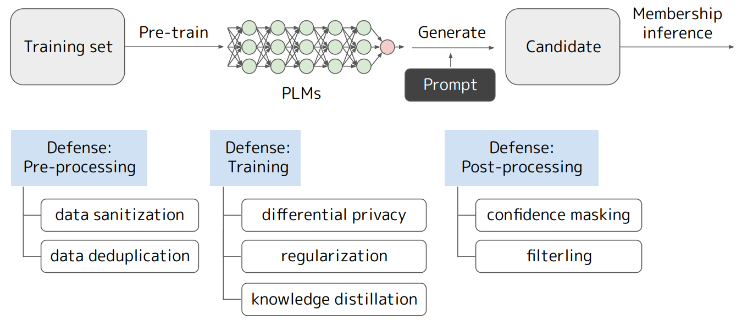
Procedure of Data Extraction Attacks and Defenses
Figure 1: The procedure of training data extraction attacks and possible defenses.

Slide 39
Contents
Background and Contribution
Preliminaries about PLMs
Definitions of Memorization
Training Data Extraction Attacks
Training Data Extraction Defense
Findings
Conclusion and Future Works

Slide 40
Findings
In this study, they evaluated the impact of the model size, the string duplication in the training set, and the length of prompts on the amount of memorization.
They found that the amount of memorization increases with the model size.
They also found that the amount of memorization increases with the string duplication in the training set.
Finally, they found that the amount of memorization decreases with the length of the prompt.

Slide 41
Larger Models Memorize More
A log-linear relationship exists between the size of the model and the number of strings memorized. This means that as the model size increases, the amount of memorization also increases.
Duplicate Strings are Memorized
Duplicate strings refer to the presence of identical or nearly identical text passages in the training data used to train pre-trained language models (PLMs).
A log-linear trend exists between the number of duplicates and the amount of memorization.

Slide 42
Longer Prompts Extract More
Longer prompts tend to extract more training data from PLMs. This is because longer prompts provide more context for the PLM, which makes it easier for the PLM to generate the desired output.

Slide 43
Contents
Background and Contribution
Preliminaries about PLMs
Definitions of Memorization
Training Data Extraction Attacks
Training Data Extraction Defense
Findings
Conclusion and Future Works

Slide 44
Conclusion
This paper provides a comprehensive survey of training data extraction from PLMs and highlights the pressing security concerns associated with it.
The study reviews over 100 papers in the field of natural language processing and security, presenting a taxonomy of memorization and systemizing approaches for attack and defense.

Slide 45
Future Works
The paper suggests several future research directions in the area of training data extraction from PLMs.
Firstly, it explores the degree of danger posed by memorized strings and differentiates between different types of memorization.
Secondly, it considers the construction of evaluation sets and develops a schema for quantitative evaluation of training data extraction from PLMs.
The paper also highlights the need for evaluation metrics based on realistic attack scenarios and proposes the use of true positive rate with a low false positive rate for membership inference evaluation.
Additionally, the study suggests the need to balance security concerns with model performance and consider the final application of PLMs.

